Slide 1


Water Management Solutions
Powered by Krisent Technologies

Slide 2

Contents
Company Introduction
Water Management Introduction
Product Models introduction
System Integration options
Billing Software explanation

Slide 3
Krisent Technologies
About US:
We are an electronics systems manufacturing company situated in Rajkot, Gujarat
We have the desire, Passion and dedication to be one of the India’s largest companies
We have with us a Team of skilled Research and Development Engineers, Production engineers with modern equipments and Marketing experts
Our Product Range:
We design and develop various electronics systems some of which are mentioned below:
Water Management Solutions
Security and Safety Solutions
Home Automation Systems and Entire Power Solutions
Industrial and Agriculture Automation
Software's and Application Development

Slide 4
Water Management Solutions
Our Water Management Solution is a system that consists of various individual products. The solution can be customized by adding or removing any of the following products as per need.
Our Solutions
Analog Water Meter
Digital Flow Totalizer
Digital Flow Totalizer with solenoid valves
Digital Flow Totalizer with Billing Software (Computer)
Digital Flow Totalizer with Cloud Integration (online Linux Hosting)

Slide 5

Analog Water Meter
Single Jet
Small, Compact Design, Light in Weight
Selected High Quality Material for
durability
Interchangeable Spare Parts for easy
maintenance
Magnetic drive with anti-magnetic shield on
demand High sensitivity, low pressure loss
Vacuum sealed register for clear reading in
longer run

Slide 6

Multi Jet Water Meter
Selected High Quality Material for durability
Interchangeable Spare Parts for easy maintenance
Magnetic drive with anti magnetic shield on demand
High sensitivity, low pressure loss
Vacuum sealed register for clear reading in longer
run Online replacement of register

Slide 7

Woltman Water Meter
Dry dial, Magnetic Drive
Measuring Accuracy Conforming to ISO 4064 CLASS-B
Interchangeable Spare Parts for easy maintenance
Online Replacement of entire Mechanism
Vacuum sealed register for clear reading in longer run High Sensitivity, low pressure loss
Selected High Quality Material for Durability

Slide 8
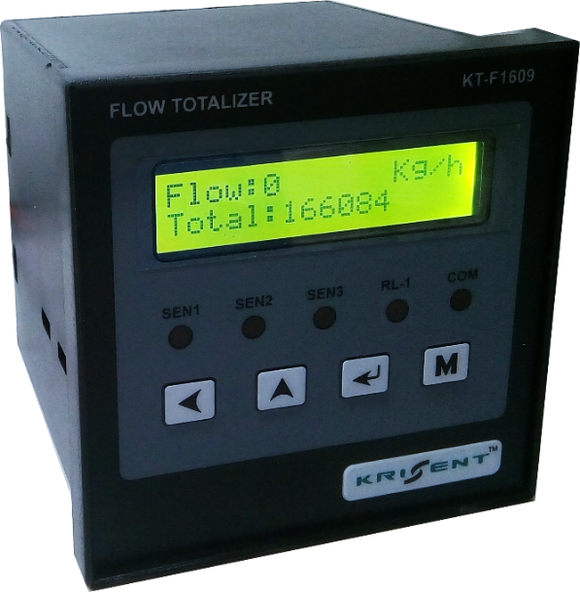

Digital Flow Totalizer
Real time flow rate and Total flow indication
Can be integrated with up to 3 water flow sensors
Flow units can be customized (like litres, gallons, etc..)
Can be integrated with PLCs using RS-485 / Modbus
/ RS-232 / USB protocols

Slide 9

Digital Flow Totalizer with solenoid valves
Real time flow rate and Total flow indication
Can be integrated with up to 3 water flow sensors
Flow units can be customized (like litres, gallons, etc..)
Can be integrated with PLCs using RS-485 / Modbus
/ RS-232 / USB protocols
This model can be integrated with solenoid valves to cut off
water supply
User can set maximum limit for water supply after which the
water supply will be cut off

Slide 10
Digital Flow Totalizer with Billing Software
This application is for Calculate Water bill ,Take route on usage of water and bill Payment.
The Software can be configured for payment as prepaid or postpaid method
Page List
Live Page
Owner Detail
Meter Detail
Bill Generate
Bill Print
Payment Generate
Cash Receipt Print
Bill Report
Other Report
Ledger Detail
COMport/Ethernet Setting
Rate Master

Slide 11
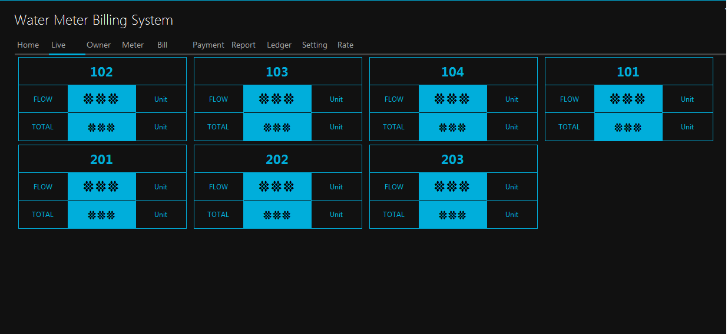
Live Page

Slide 12
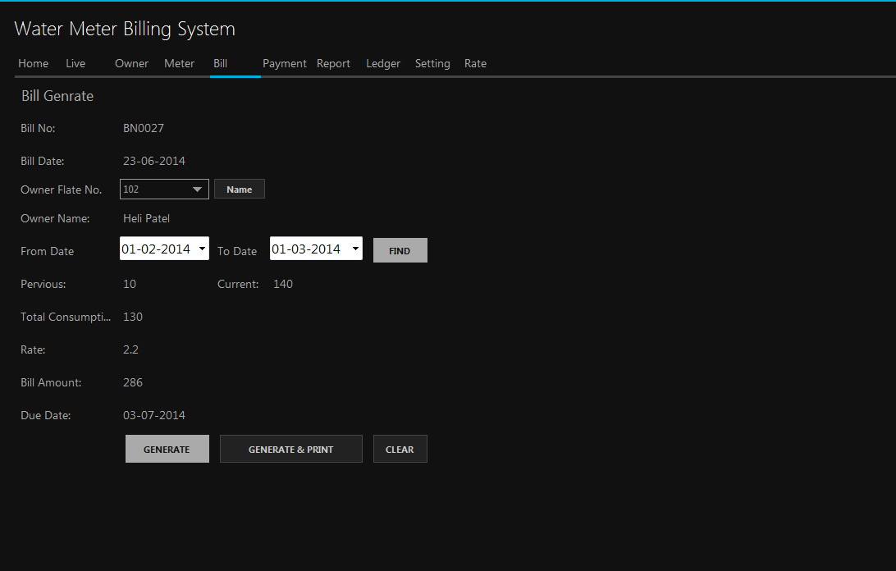
Bill

Slide 13
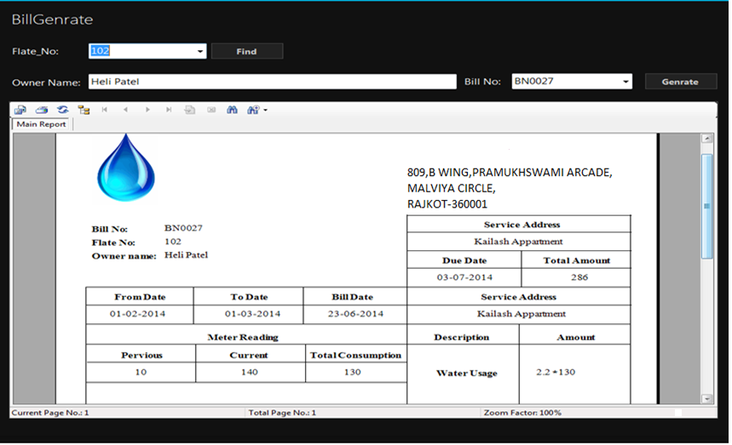
Bill Print

Slide 14
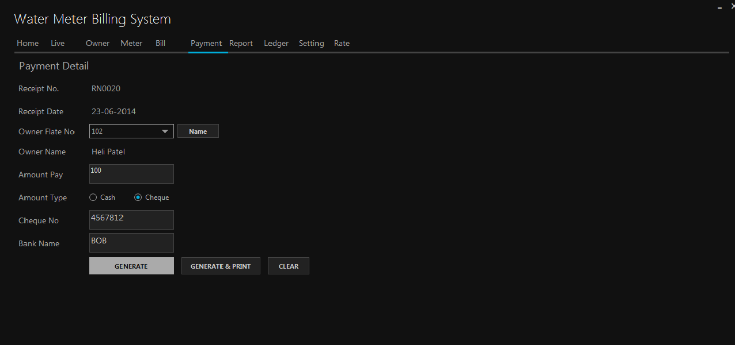
Payment

Slide 15
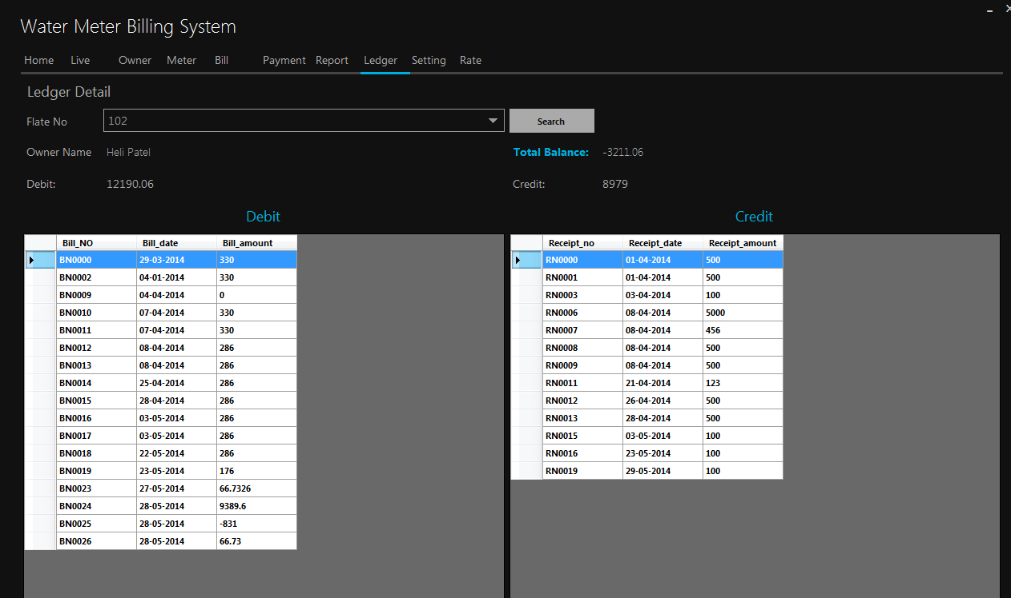
Ledger

Slide 16
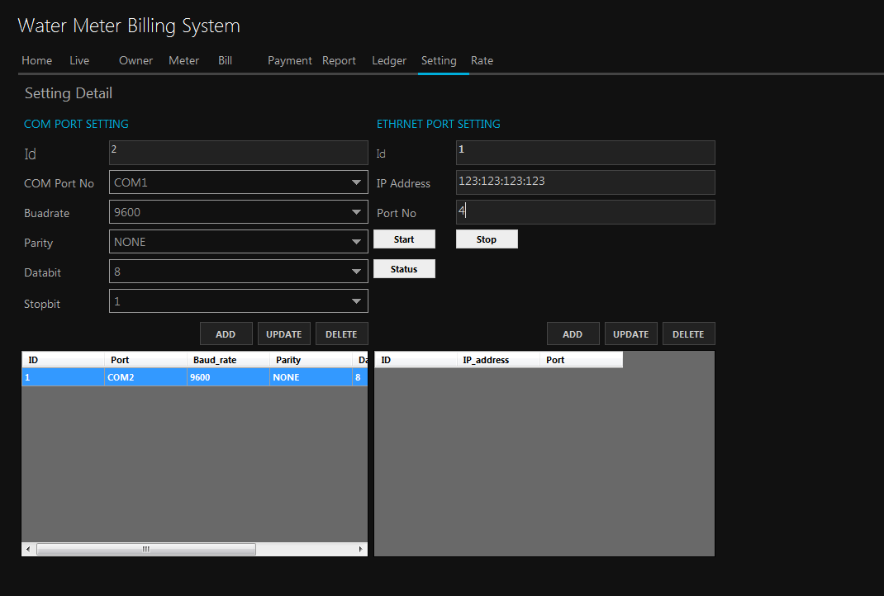
Configuration

Slide 17
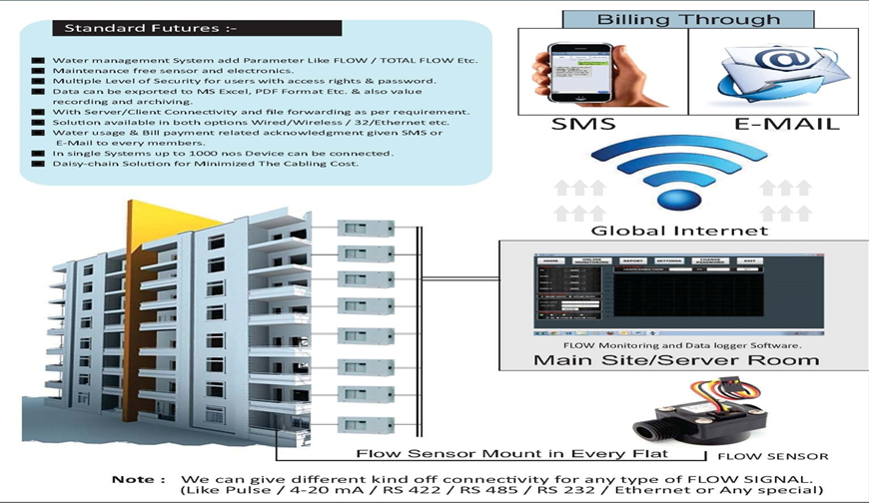
Digital Flow Totalizer with Cloud Integration

Slide 18
System Customization and Integration
Sr. No. | Component | Specifications | Description
1 | Water flow sensor | ABS body | Flow sensor will be installed in the main pipe.
 |  | 1.5 inch diameter (40 mm) | It will sense the flow of water and will send signals to Flow Totalizer
 |  | Flow rate as per requirement | It will be connected to Flow Totalizer using 3 wires
2 | Local Live monitoring solution | LCD screen | All the Flow Totalizers of entire building will be connected to the main CPU hub using two wires each
 |  |  | The main CPU hub will be connected to an LCD screen using HDMI cable
 |  |  | The LCD screen will show real time inflow of water in each and every flat simultaneously
 |  | No Live monitoring | The live monitoring feature is disabled and so real time flow rate and total flow is available for the owner at individual Flow Totalizer displays
3 | Flow Toalizer display | Separate personal display | The model of Flow Totalizer with display will be installed inside or near the main gate of the flat as per convenience
 |  | Real time flow rate (LPM) and total flow display | The display is 16x2 character LCD used for industrial applciations
 |  | No separate display | All the Flow totalizers will be installed in the parking / security cabin in panel enclosure
 |  |  | The flow sensors that are installed for each flat will be connected to their respective flow totalizer in the panel using wires
 |  | Blind Totalizer | This option is only available if the water management solution is equipped with live monitoring solution
 |  |  | The Flow Totalizer will be installed in the panel enclosure in parking/security cabin
 |  |  | All the Flow Totalizers will be connected to main CPU hub using two wires each
 |  |  | The main CPU hub will be connected to an LCD screen using HDMI cable

Slide 19
4 | Local Software Access | Real time monitoring live page | This page will show real time Flow rate and total flow of each and every flat in the building
 |  | Owner details | This page will show details of the owner of the flat
 |  | Meter details | This page will show technical details of the Flow Totalizer that is installed in the flat
 |  | Bill generate and print | This page will generate the bill according to the water consumption of individual flat weekly, monthly, quarterly etc..
 |  | Cash receipt generate and print | This page will generate and print the cash receipt
 |  | Payment reports | This page can generate payment details in the previous week, month, year, etc..
 |  | Water consumption reports | This page can generate water consumption details in the previous week, month, year, etc..
 |  | Ledger details | This page will show all the ledger details of individual account till date
 |  | Currency converter / Rate master | This page is required to input the converter for generating the water bill
 |  | COM port / ethernet setting | This page is only used during installation for integrating all the flow toalizers with the main CPU hub
 |  | No software integration will be available | This feature will exclude all the above mentioned features of the software
5 | Battery backup | Battery backup for individual flat | Every Flow Totalizer will be equipped with a battery having backup of 12 hours
 |  |  | This will enable the water management even in the case of electricity fail which helps in counting eery litre of water inflow
 |  | No battery backup | No battery backup will be installed in the flow totalizer
 |  |  | This will switch off the individual flow totalizers in case of electricity fail
6 | GSM technology | Inbuilt GSM technology in every Flow Totalizer | Every Flow Totalizer will be having an inbuilt GSM modem which will require separate individual SIM card
 |  | Separate SIM card for eah Flow Totalizer | This will enable the owner to get SMS notifications for 20%, 50%, 75%, etc.. Usage of maximum flow
 |  | Customized SMS notifications | Customized calling solutions are also integrated as per requirement
 |  | No inbuilt GSM technology | GSM technology will not be integrated

Slide 20
7 | Water control | Limited water usage | This feature will enable water cutoff in every flat using solenoid valve
 |  |  | Every owner shall register a maximum flow of water in the month (in Litres)
 |  | Water cutoff | If the water consumption of the flat exceeds that of the maximum registered flow of corresponding flat then water inflow will be cutoff
 |  |  | The water inflow can be resumed if maximum flow is reset or extended
 |  | Unlimited water usage | This feature will not limit the owner to use water to any extent
 |  |  | No water cutoff is available in this case
8 | E-Mails | Customized E-Mail notification | This feature is only available if software feature is selected
 |  |  | This feature will also require internet at the PC / Laptop
 |  |  | If this feature is selected then customized reports about water consumption, bills, cash receipts, ledger details, payment history, etc.. Can be mailed to indicidual owners
 |  |  | The mails can also be automated as per requirement
 |  | E-mail feature not available | The owner won't be able to get any reports or above mentioned details in his/her mail
9 | Global live monioring solution | Global access to real time data on PC / Laptop | This feature will give user all the facilities as mentioned in local live monitoring solution globally
 |  |  | The owner can login the software from any laptop (with good internet connection) and get real time details of water consumption
 |  | Global access to real time data on smartphone | This feature will give user all the facilities as mentioned in local live monitoring solution globally
 |  |  | The owner can download our smartphone application, login and get real time details of water consumption
 |  | Global access won't be available | In this case local live monitoring feature is enabled
10 | Global software access | Global access to all software features on PC / Laptop | This feature will give user all the facilities as mentioned in local software access globally
 |  |  | The owner can login the software from any laptop (with good internet connection) and can use all the features like reports, payment history, live monitoring, etc.. Globally
 |  | Global access to all software features on smartphone | This feature will give user all the facilities as mentioned in local software access solution globally
 |  |  | The owner can download our smartphone application, login and get access to all the features of desktop application in his/her smartphone
 |  | Global access won't be available | In this case local software access feature is enabled

Slide 21


Slide 22


Krisent Technologies
Krisent House, B/H Poojara Telecom,
Mansatta Chowk, Near S.T. Workshop,
Gondal Road, Rajkot, Gujarat – 360002
Mail : niraj@Krisent.co.in
Ph. : +91 9409660429

